Slide 1
The Chef Server
A Hub for Configuration Data

Slide 2
Objectives
After completing this module, you should be able to
Connect your local workstation (laptop) to a Chef Server
Use the knife command to upload cookbooks to a Chef Server
Bootstrap a node
Manage a node via a Chef Server.

Slide 3
Hosted Chef
More easily manage multiple nodes
Create a Hosted Chef Account
Upload our cookbooks to the Hosted Chef Server
Add our old workstation as a managed node
Notes:
TBD: Need script. After the last slide are slides that we might add to the beginning of this module.

Slide 4
$ cd ~/chef-repo
Notes:
add this from other decks?

Slide 5
$ knife client list
ORGNAME-validator

Slide 6
Hosted Chef
More easily manage multiple nodes
Create a Hosted Chef Account
Upload our cookbooks to the Hosted Chef Server
Add our old workstation as a managed node
Notes:
knife cookbook list to make sure they are in the right local chef-repo

Slide 7
$ knife cookbook --help
** COOKBOOK COMMANDS **
knife cookbook bulk delete REGEX (options)
knife cookbook create COOKBOOK (options)
knife cookbook delete COOKBOOK VERSION (options)
knife cookbook download COOKBOOK [VERSION] (options)
knife cookbook list (options)
knife cookbook metadata COOKBOOK (options)
knife cookbook metadata from FILE (options)
knife cookbook show COOKBOOK [VERSION] [PART] [FILENAME] (options)
knife cookbook test [COOKBOOKS...] (options)
knife cookbook upload [COOKBOOKS...] (options)

Slide 8
$ knife cookbook list
Notes:
You can use search as long as you have chef server.
sometimes knife cookbook list doesn't work?

Slide 9
$ cd cookbooks/apache

Slide 10
$ berks --help
Commands:
berks apply ENVIRONMENT # Apply version locks from Berksfile.lock to a Chef environment
berks contingent COOKBOOK # List all cookbooks that depend on the given cookbook in your
berks cookbook NAME [PATH] # Create a skeleton for a new cookbook
berks help [COMMAND] # Describe available commands or one specific command
berks info [COOKBOOK] # Display name, author, copyright, and dependency information
berks init [PATH] # Initialize Berkshelf in the given directory
berks install # Install the cookbooks specified in the Berksfile
berks list # List cookbooks and their dependencies specified by your
berks outdated [COOKBOOKS] # List dependencies that have new versions available that
berks package [PATH] # Vendor and archive the dependencies of a Berksfile
berks search NAME # Search the remote source for cookbooks matching the partial

Slide 11
$ berks install
Resolving cookbook dependencies...
Fetching 'apache' from source at .
Fetching cookbook index from https://supermarket.chef.io...
Using apache (0.2.1) from source at .

Slide 12
$ berks upload
Uploaded apache (0.2.1) to: 'https://api.opscode.com:443/organizations/vogue'

Slide 13
$ knife cookbook list
apache 0.2.1

Slide 14
Upload Cookbook
Upload your remaining cookbooks
Verify that are all uploaded

Slide 15
$ cd ~/chef-repo/cookbooks/workstation

Slide 16
$ knife cookbook list
apache 0.2.1

Slide 17
$ berks install
Resolving cookbook dependencies...
Fetching 'workstation' from source at .
Fetching cookbook index from https://supermarket.chef.io...
Using workstation (0.2.1) from source at .

Slide 18
$ berks upload
Uploaded workstation (0.2.1) to: 'https://api.opscode.com:443/organizations/vogue'

Slide 19
$ knife cookbook list
apache 0.2.1
workstation 0.2.1

Slide 20
Hosted Chef
More easily manage multiple nodes
Create a Hosted Chef Account
Upload our cookbooks to the Hosted Chef Server
Add our old workstation as a managed node

Slide 21
$ cd ~/chef-repo

Slide 22
$ knife bootstrap FQDN -x USER -P PWD --sudo -N node1
Connecting to ec2-204-236-155-223.us-west-1.compute.amazonaws.com
ec2-204-236-155-223.us-west-1.compute.amazonaws.com Starting first Chef Client run...
ec2-204-236-155-223.us-west-1.compute.amazonaws.com Starting Chef Client, version 12.3.0
ec2-204-236-155-223.us-west-1.compute.amazonaws.com Creating a new client identity for node1 using the validator key.
ec2-204-236-155-223.us-west-1.compute.amazonaws.com resolving cookbooks for run list: []
ec2-204-236-155-223.us-west-1.compute.amazonaws.com Synchronizing Cookbooks:
ec2-204-236-155-223.us-west-1.compute.amazonaws.com Compiling Cookbooks...
ec2-204-236-155-223.us-west-1.compute.amazonaws.com [2015-05-15T21:59:18+00:00] WARN: Node node1 has an empty run list.
ec2-204-236-155-223.us-west-1.compute.amazonaws.com Converging 0 resources
ec2-204-236-155-223.us-west-1.compute.amazonaws.com
ec2-204-236-155-223.us-west-1.compute.amazonaws.com Running handlers:

Slide 23
$ knife node --help
FATAL: Cannot find sub command for: 'node --help'
Available node subcommands: (for details, knife SUB-COMMAND --help)
** NODE COMMANDS **
knife node bulk delete REGEX (options)
knife node create NODE (options)
knife node delete NODE (options)
knife node edit NODE (options)
knife node environment set NODE ENVIRONMENT
knife node from file FILE (options)
knife node list (options)
knife node run_list add [NODE] [ENTRY[,ENTRY]] (options)
knife node run_list remove [NODE] [ENTRY[,ENTRY]] (options)

Slide 24
$ knife node list
node1

Slide 25
$ knife node show node1
Node Name: node1
Environment: _default
FQDN: ip-10-198-51-26.us-west-1.compute.internal
IP: 204.236.155.223
Run List:
Roles:
Recipes:
Platform: ubuntu 14.04
Tags:

Slide 26
$ knife node run_list add node1 "recipe[apache]"
node1:
run_list: recipe[apache]

Slide 27
Hosted Chef
More easily manage multiple nodes
Create a Hosted Chef Account
Upload our cookbooks to the Hosted Chef Server
Add our old workstation as a managed node

Slide 28
Discussion
What questions can we help you answer?

Slide 30
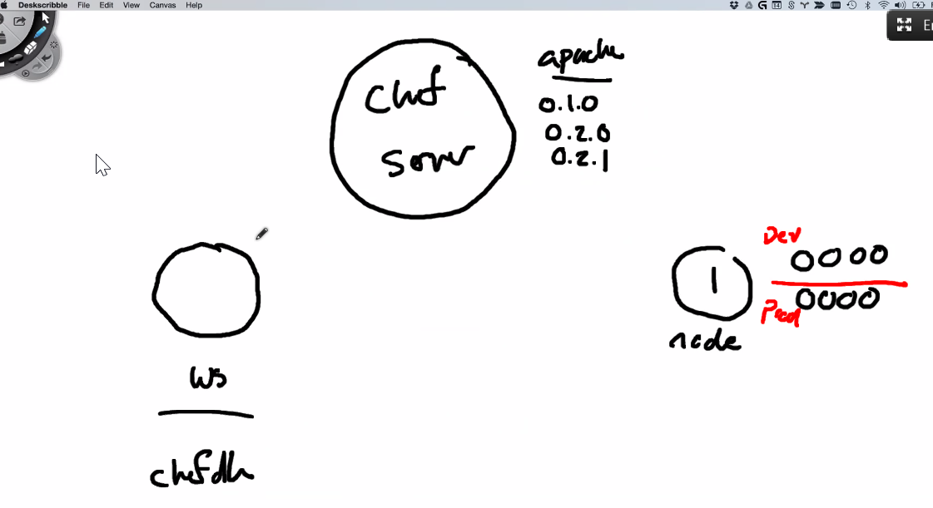
Hosted Chef
More easily manage multiple nodes
Create a Hosted Chef Account
Upload our cookbooks to the Hosted Chef Server
Add our old workstation as a managed node
Notes:
TBD: Need script

Slide 31
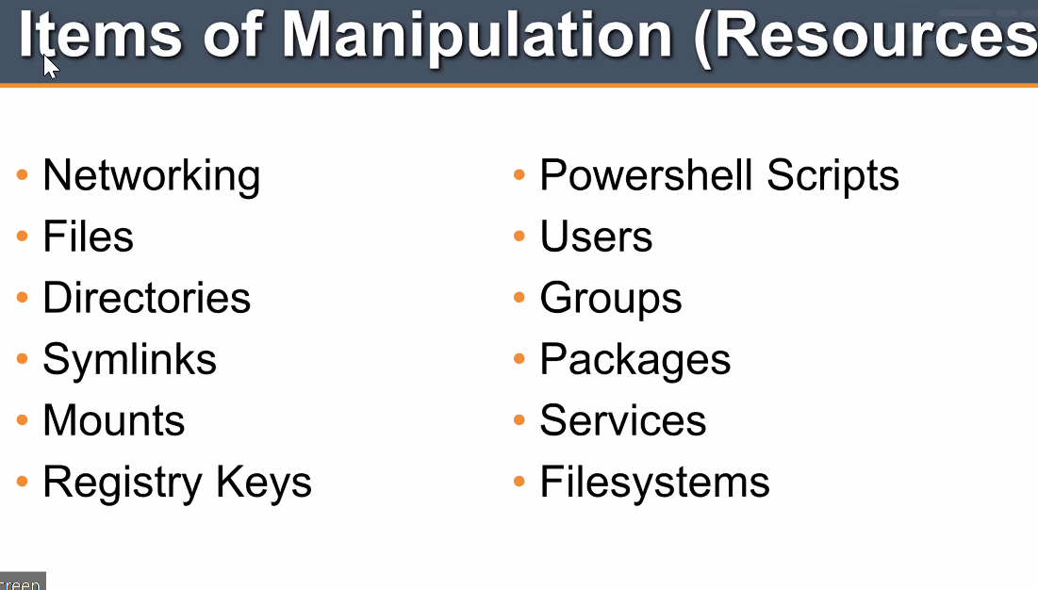
$ cd ~/chef-repo
Notes:
add this from other decks?

Slide 32
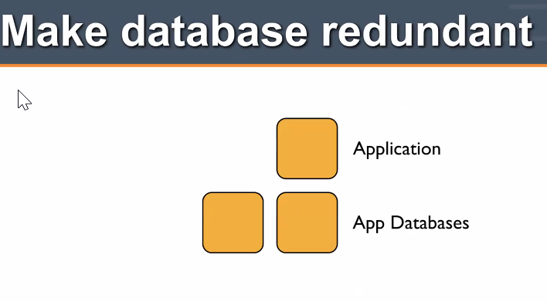
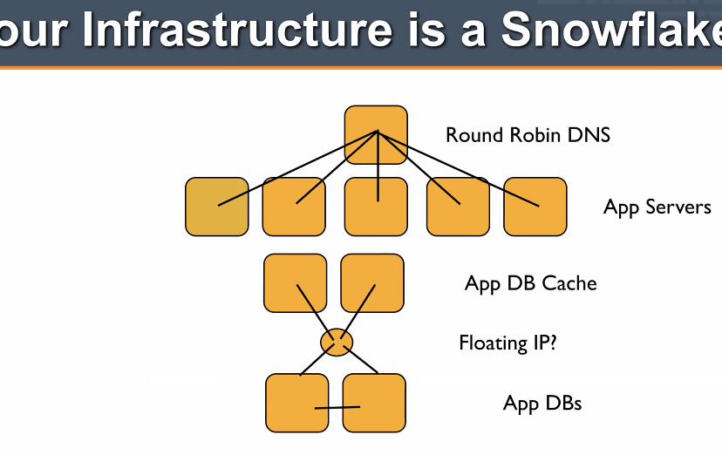
$ knife client list
ORGNAME-validator

Slide 33
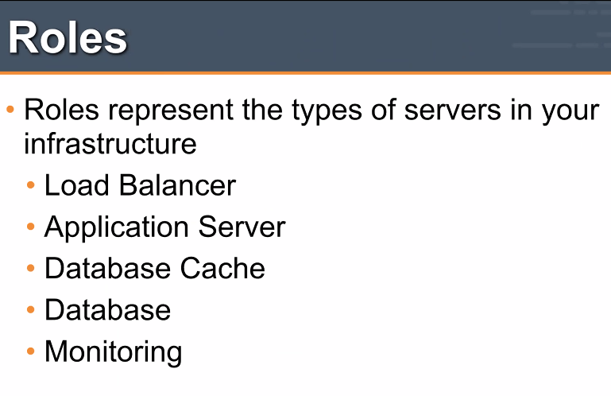
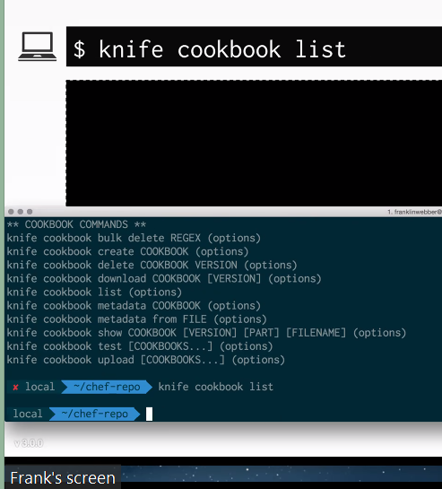
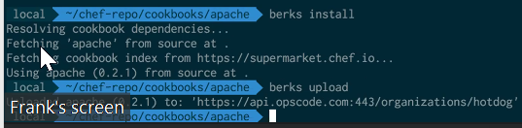
Hosted Chef
More easily manage multiple nodes
Create a Hosted Chef Account
Upload our cookbooks to the Hosted Chef Server
Add our old workstation as a managed node
Notes:
knife cookbook list to make sure they are in the right local chef-repo

Slide 34
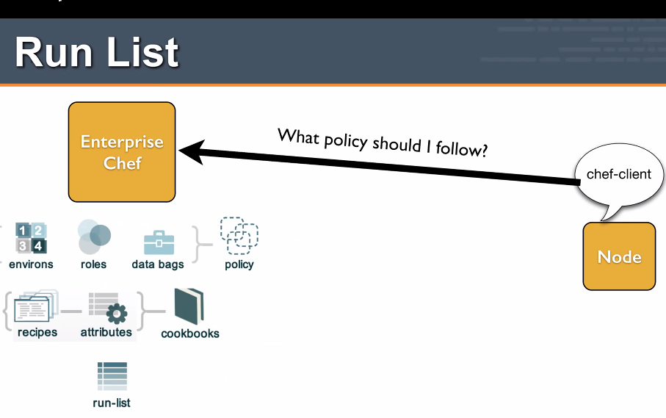
$ knife cookbook --help
** COOKBOOK COMMANDS **
knife cookbook bulk delete REGEX (options)
knife cookbook create COOKBOOK (options)
knife cookbook delete COOKBOOK VERSION (options)
knife cookbook download COOKBOOK [VERSION] (options)
knife cookbook list (options)
knife cookbook metadata COOKBOOK (options)
knife cookbook metadata from FILE (options)
knife cookbook show COOKBOOK [VERSION] [PART] [FILENAME] (options)
knife cookbook test [COOKBOOKS...] (options)
knife cookbook upload [COOKBOOKS...] (options)

Slide 35
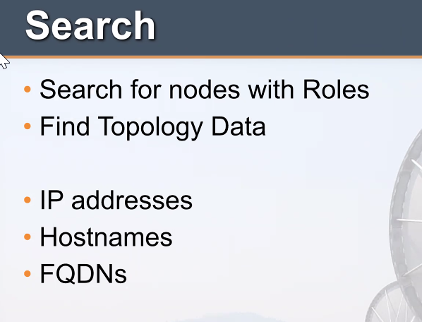
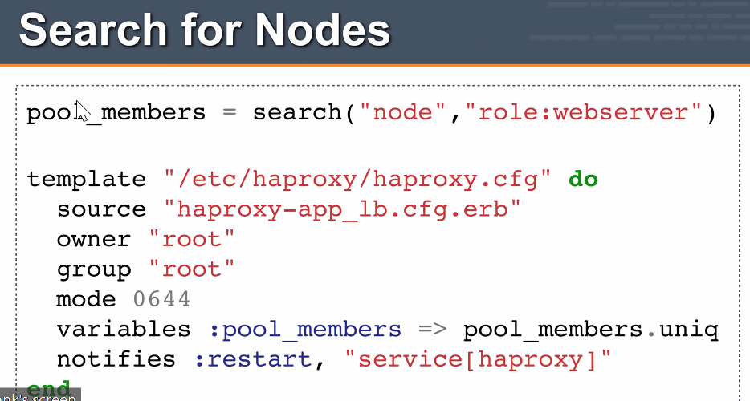
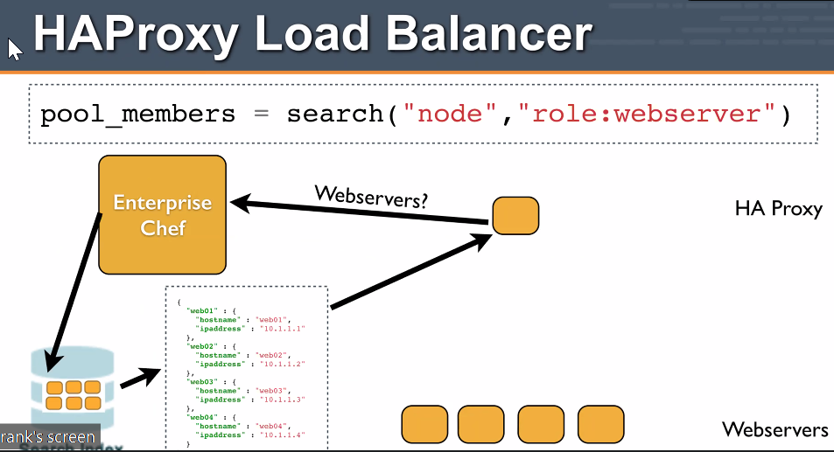
$ knife cookbook list
Notes:
You can use search as long as you have chef server.
sometimes knife cookbook list doesn't work?

Slide 36
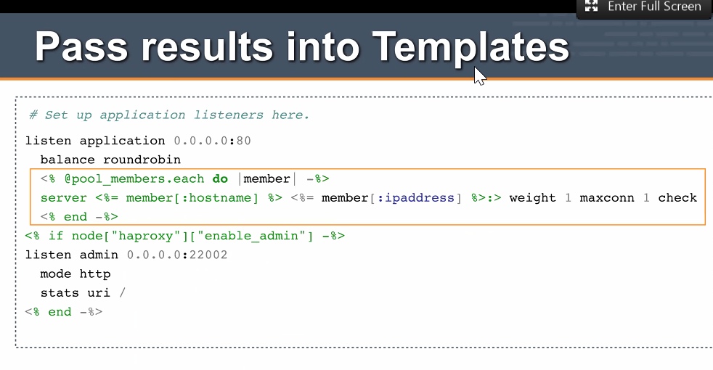
$ cd cookbooks/apache

Slide 37
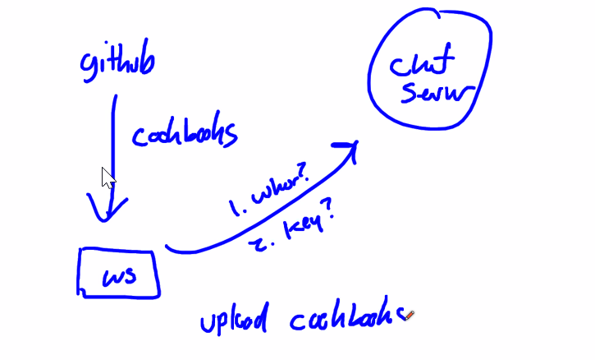
$ berks --help
Commands:
berks apply ENVIRONMENT # Apply version locks from Berksfile.lock to a Chef environment
berks contingent COOKBOOK # List all cookbooks that depend on the given cookbook in your
berks cookbook NAME [PATH] # Create a skeleton for a new cookbook
berks help [COMMAND] # Describe available commands or one specific command
berks info [COOKBOOK] # Display name, author, copyright, and dependency information
berks init [PATH] # Initialize Berkshelf in the given directory
berks install # Install the cookbooks specified in the Berksfile
berks list # List cookbooks and their dependencies specified by your
berks outdated [COOKBOOKS] # List dependencies that have new versions available that
berks package [PATH] # Vendor and archive the dependencies of a Berksfile
berks search NAME # Search the remote source for cookbooks matching the partial
berks shelf SUBCOMMAND # Interact with the cookbook store
berks show [COOKBOOK] # Display the path to a cookbook on disk
berks update [COOKBOOKS] # Update the cookbooks (and dependencies) specified in the
berks upload [COOKBOOKS] # Upload the cookbook specified in the Berksfile to the Chef
berks vendor [PATH] # Vendor the cookbooks specified by the Berksfile into a berks
berks verify # Perform a quick validation on the contents of your resolved
berks version # Display version
berks viz # Visualize the dependency graph

Slide 38
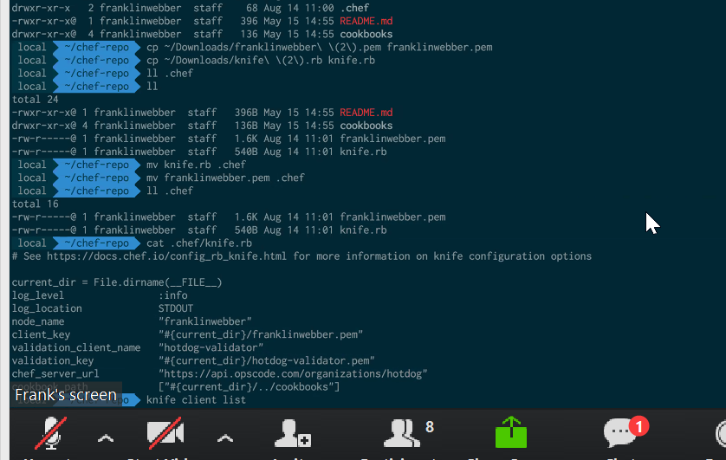
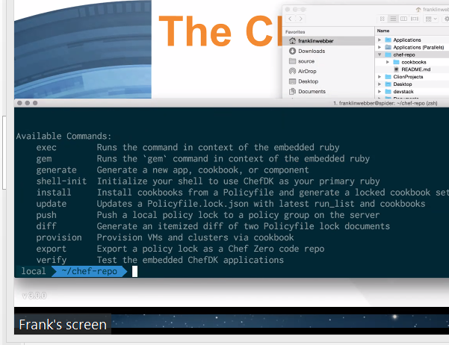
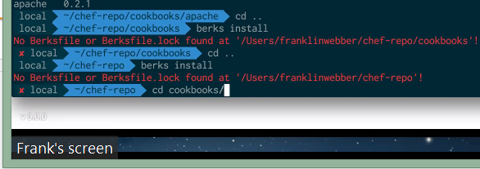
$ berks install
Resolving cookbook dependencies...
Fetching 'apache' from source at .
Fetching cookbook index from https://supermarket.chef.io...
Using apache (0.2.1) from source at .
Notes:
Talking about how this runs locally now
last pic – dude in wrong dir.

